Slide 1
An Electric Craving
UCSD Data Science and Programming Bootcamp
Project One
Jacob Zacarias
Sanabu Washizuka
Tanlin Hung
Walaa Alani

Slide 2

Introduction
"Todd"
Lives in San Diego, CA
Enjoys rock climbing
A foodie
Looking to buy a new car

Slide 3
Theme of the Study
Should I get an electric vehicle over a gas-powered car?

Slide 4
EV or Gas Car?
Q1. Will I be able to find charging stations wherever I am?
Q2. Out of both categories (EVs and gas-powered cars) which make and model is the most cost-effective for their fuel?
Q3. Will EVs really pay themselves off?
Q4. What factors might hint that a city has a lot of charging stations?
Q5. How much will I save on a trip?

Slide 5
Brief Summary of findings
Q1. Will I be able to find charging stations wherever I go?
Simple search on the web,
Google map: ‘search charging stations near me’,
Using applications: ‘PlugShare, Open Charge Map’
And off course you can charge it at home ☺
Any of the above and more will give you the locations where you can find outlets to charge your car And the fun part is some of them will be for free!

Slide 6
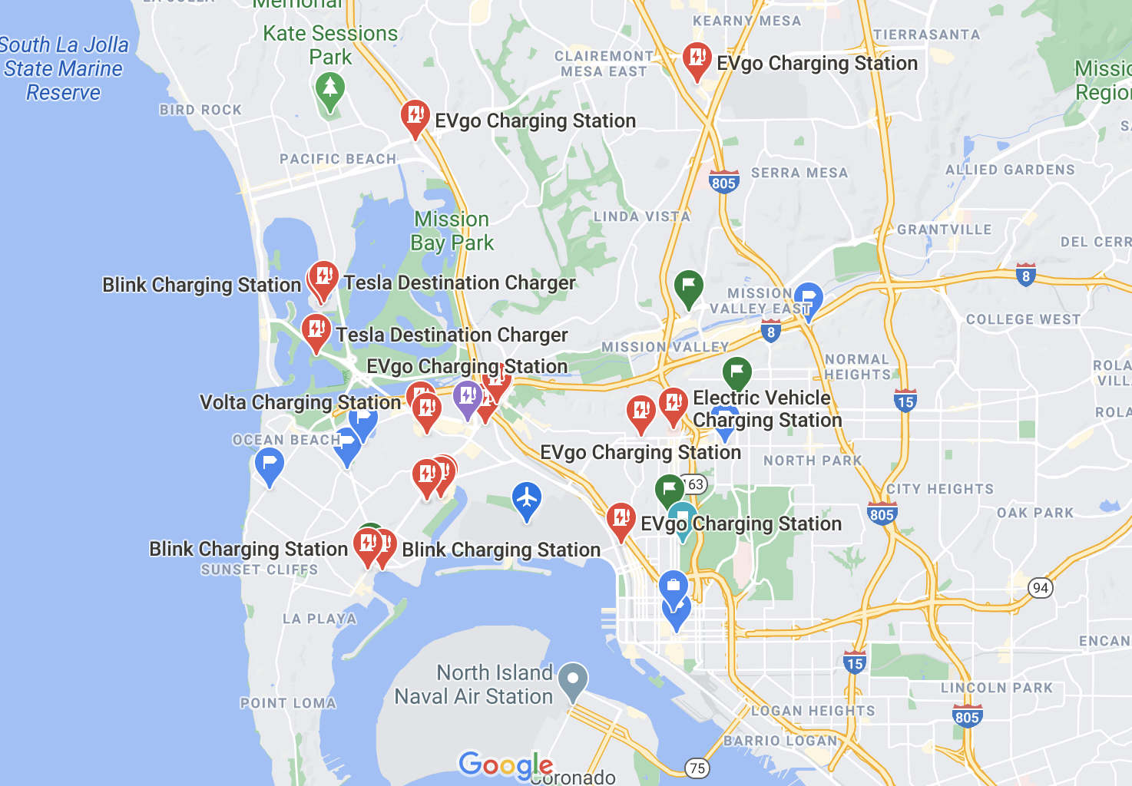
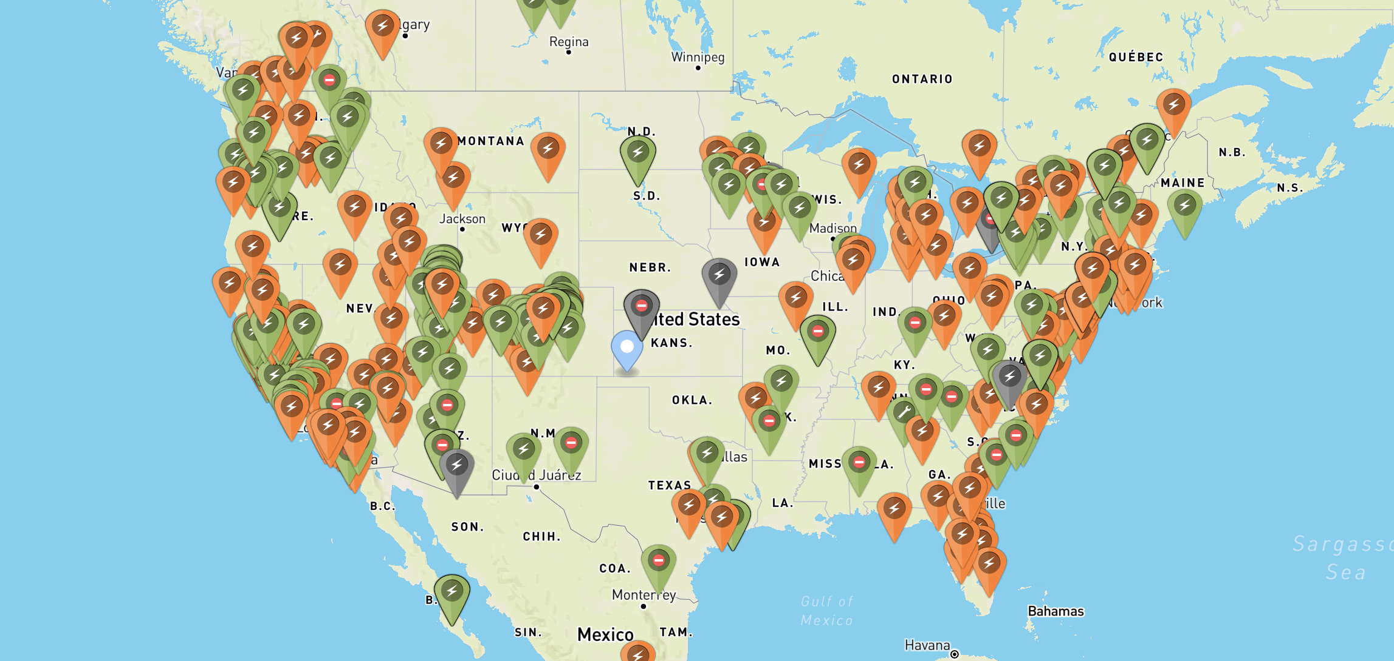
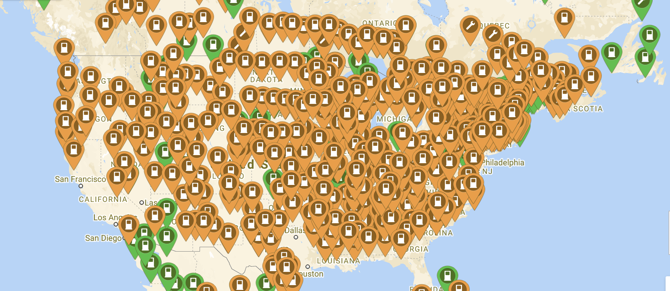
Google Map
Open Charge Map
PlugShare

Slide 7
Q2. Out of both categories (EVs and gas-powered cars) which make and model is the most cost-effective for their fuel?
For Gas powered vehicles the Toyota Camry and the Honda Civic get amazing miles per gallon for an aiming price that usually goes from 20k to 25k. As for the EV’s Americas two favorite EV’s are the Nissan Leaf and the Tesla Model 3 as they are both affordable and get great mileage for being an electric vehicle.
Q3. Will EVs really pay themselves off?
Compared to most cars the Tesla model 3 and the Nissan Leaf can easily pay themselves off in a 10 year span. When it comes to the Sedan Toyota Camry the top sold EV the Tesla Model 3 falls short in the top states like Wyoming and California. This is due to the 13k difference in pricing of the two cars as it will take more than 10 years to get the payoff in just the top states.
As for the bottom 3 states your car wont last long enough to get the pay out.

Slide 8
Brief Summary of findings
Q4. What factors might hint that a city has a lot of charging stations?
Most all of the observed factors, including population density and gas prices, did not show a significant correlation between those factors and the number of charging stations available in the city. (except for maybe one of these factors…)
Q5. How much will I save on a trip?
(summary here?)

Slide 9
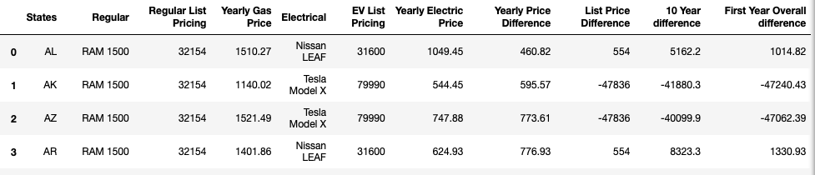
Q3 Pt 1 The Two types of Graphs
Top selling EV and Car in the US compared in each state
Top selling EV and Gas in each state comparison

Slide 10
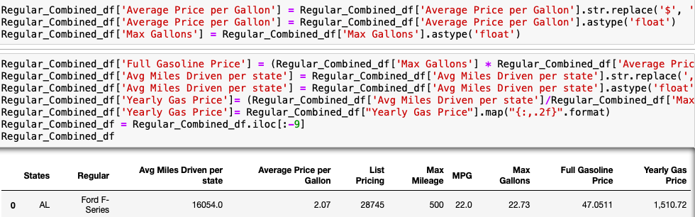
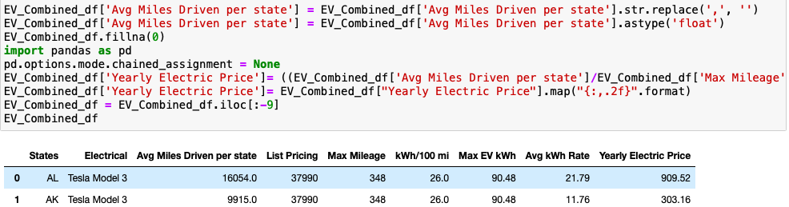
Q3 pt 2 Coding process
Coding Process to receive the Yearly gas and EV price for each state
Tesla 3 vs Ford F series

Slide 11
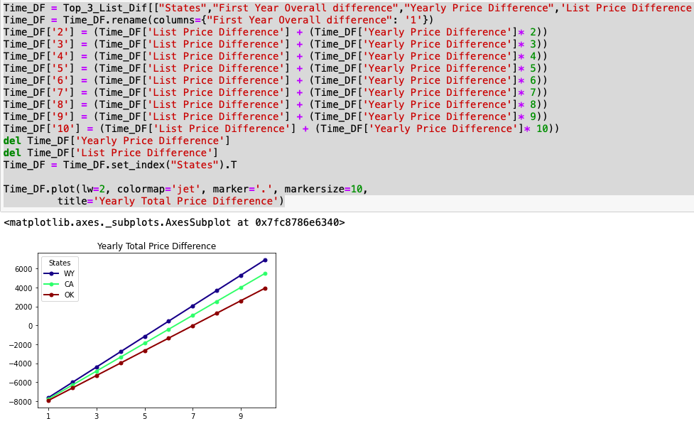
Q3 pt 3 Coding
Coding for 10 year graph of total yearly price difference.

Slide 12
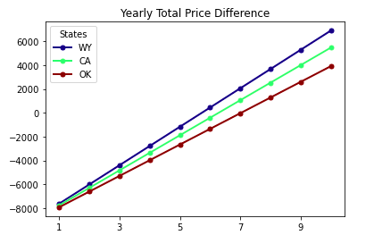
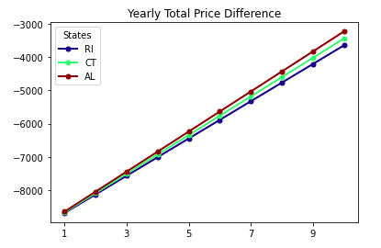
Q3 pt 4Tesla 3 vs Ford F Series
Years it takes for Tesla to payout the Price Difference
Top 3 States
Bottom 3 States

Slide 13
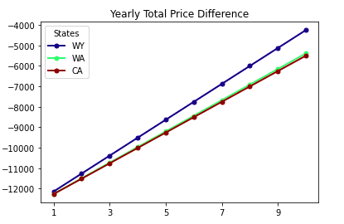
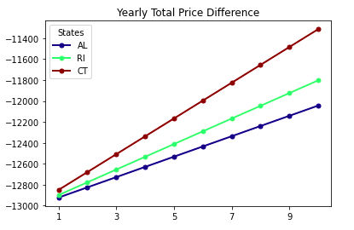
Q3 pt 5 Tesla 3 vs Toyota Camry
Years it takes for Tesla to payout the Price Difference
Top 3 States
Bottom 3 States

Slide 14
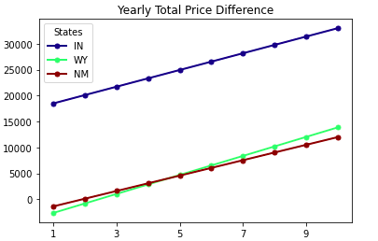
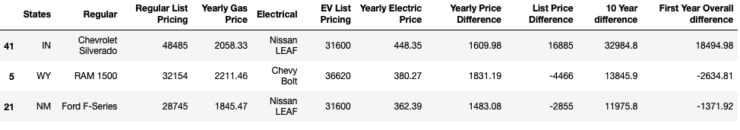
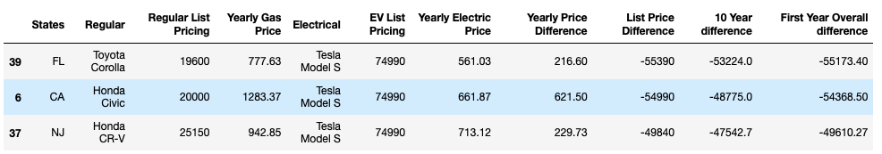
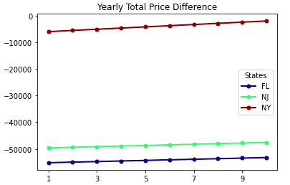
Q3 pt 6 Top Cars in each State EV vs Gasoline
Years it takes for top EV to payout in each state Price Difference

Slide 15
Q3 Will EVs really pay themselves off?
With the code we ran we were able to find if the Tesla 3 with a selling Price of $37,990 will be able to pay off
The difference in prices between the Ford F-Series and the Toyota Camry.
For the top three states like Wyoming, California and Oklahoma the EV owner will actually make a net positive
over 3k from the differential pricing.
For the bottom three states that is Rhode Island, Connecticut , and Alabama the Ev owners would be
a few thousand dollars behind the breaking point to even out the price differences.
When it comes down to the Toyota Camry, EV owners would be 4 to 6 thousand dollars away from reaching
the breaking point.
The price difference between the Tesla 3 and the Toyota Camry in the top three states were 4 k to 6k away
from reaching the breakpoint in a ten year span.
For the the worst three states you would barely make 2k back.
The reasons for this big disparity is do to the affordable fuel efficient costs of the Toyota Camry that minimize
the cheap fuel alternative the EV’s provide

Slide 16
Q.4 What factors might hint that a city has plentiful charging stations?
"If I were to move or travel elsewhere, what other factors could I look at to see how reliably I can find a charge station?“
In other words, what properties of a city correlates with how many charge stations are available there?

Slide 17
Q.4 Correlational Study
Correlational Study of the "No. of Charge Stations" against other factors within a city
Review "No. of Charge Stations" against :
City Population Density (metropolitan areas = more charge stations?)
Gas Prices (CA only study) (cheaper gas = more charge stations?)
Institution type 1 (to be named later) (more “institution type 1” = more charge stations?)
Institution type 2 (to be named later) (more “institution type 2” = more charge stations?)

Slide 18
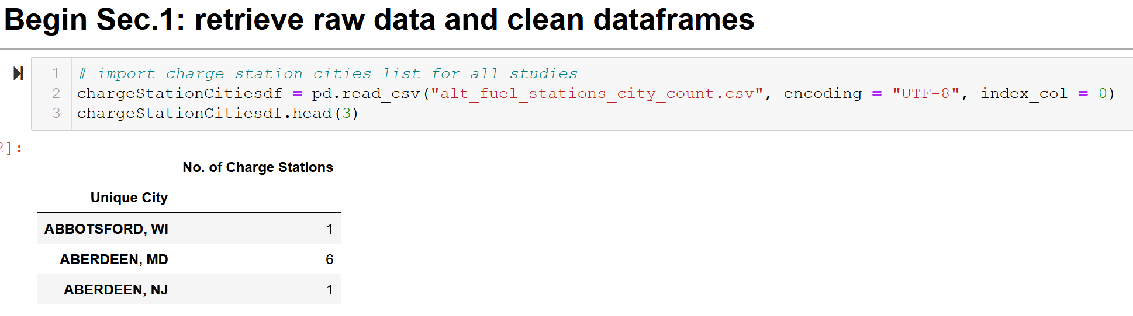
Q.4.1 – Charging Station List

Slide 19
Q.4.1 - City List and City Population Density (cleaning)
Source:
https://simplemaps.com/data/us-cities
General Info:
Information on cities in the U.S.
Updated as of November 18, 2020
Over 108,000 cities and towns from all 50 states
Used to retrieve current data on population density per city

Slide 20
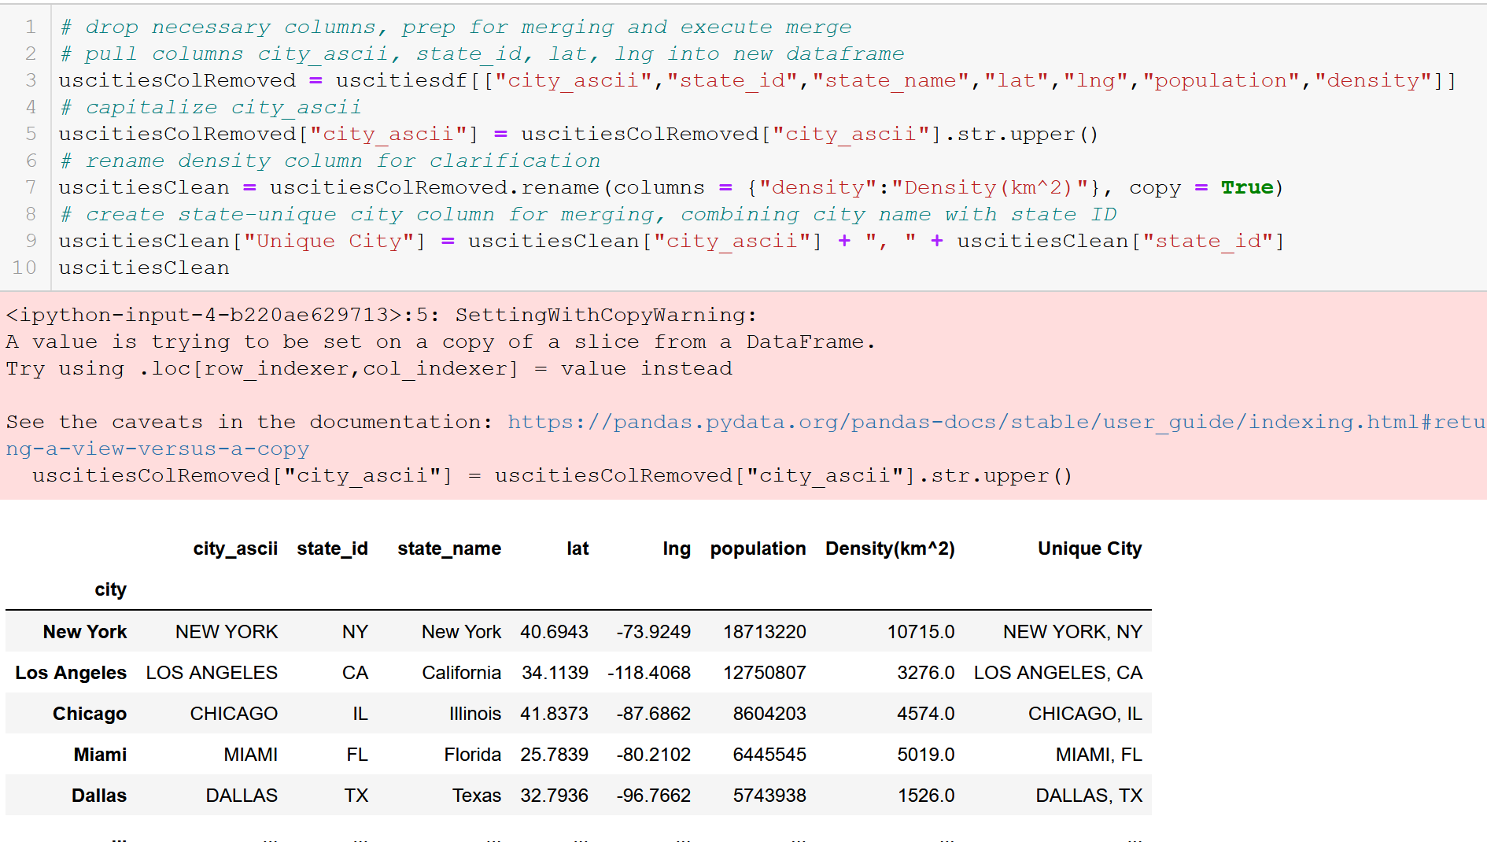
Q.4.1 - City List and City Population Density (cleaning)
*Note line 9

Slide 21
Q.4.1 – Urbanized Areas (cleaning)
Source:
https://en.wikipedia.org/wiki/List_of_United_States_urban_areas
General Info:
A list of urban areas in the United States as defined by the United States Census Bureau
An urbanized area (UA) is an urban area with population over 50,000
Used to limit cities to observe for API call

Slide 22
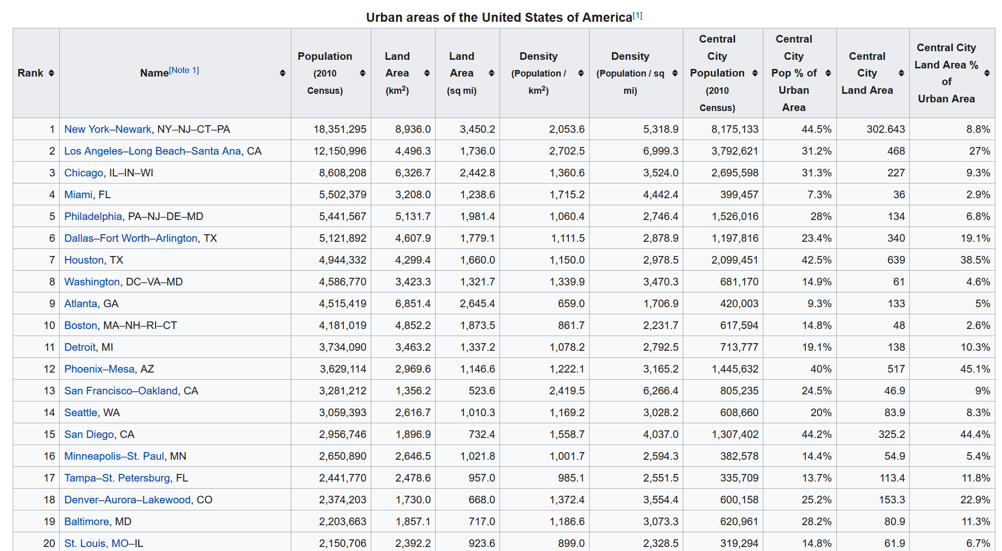
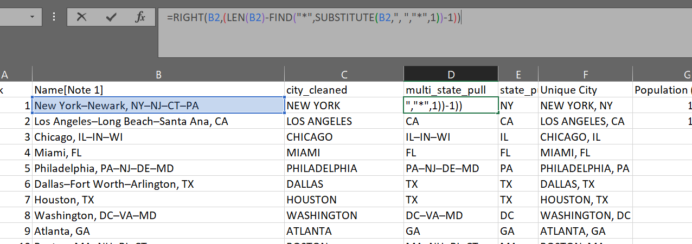
Q.4.1 – Urbanized Areas (cleaning)
Creating state-unique city names within Excel for merging

Slide 23
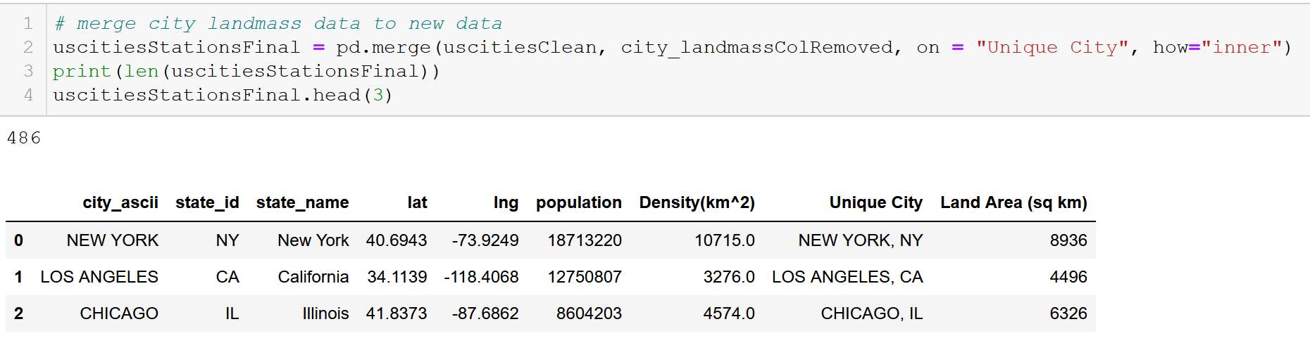
Q.4.1 – Merge urban areas list to city data frame to limit city count
Limiting cities to “Urbanized Areas” (population > 50,000)
Merging cities dataframe with “city_landmass” dataframe

Slide 24
Q.4.2 – CA Gas Prices (cleaning)
Source:
https://gasprices.aaa.com/state-gas-price-averages/
General Info:
A list of gas prices within California per city

Slide 25
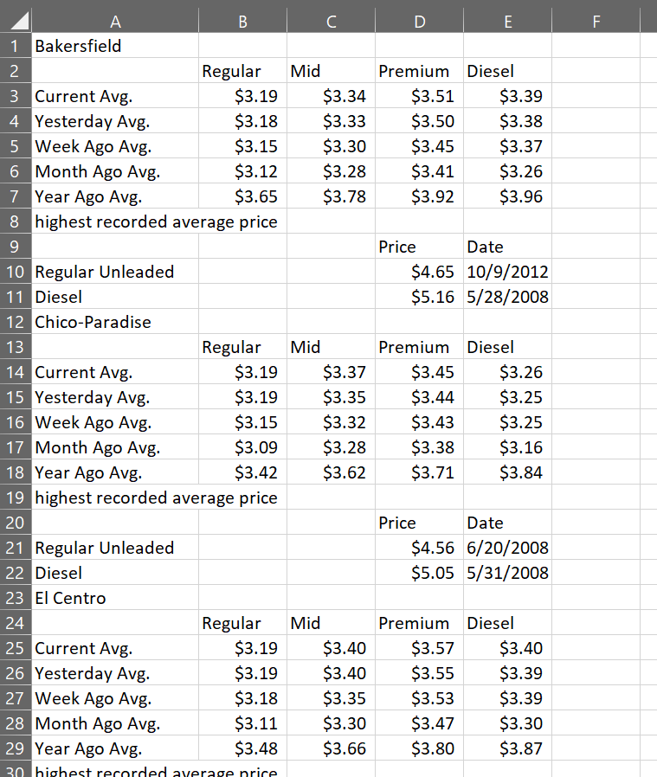
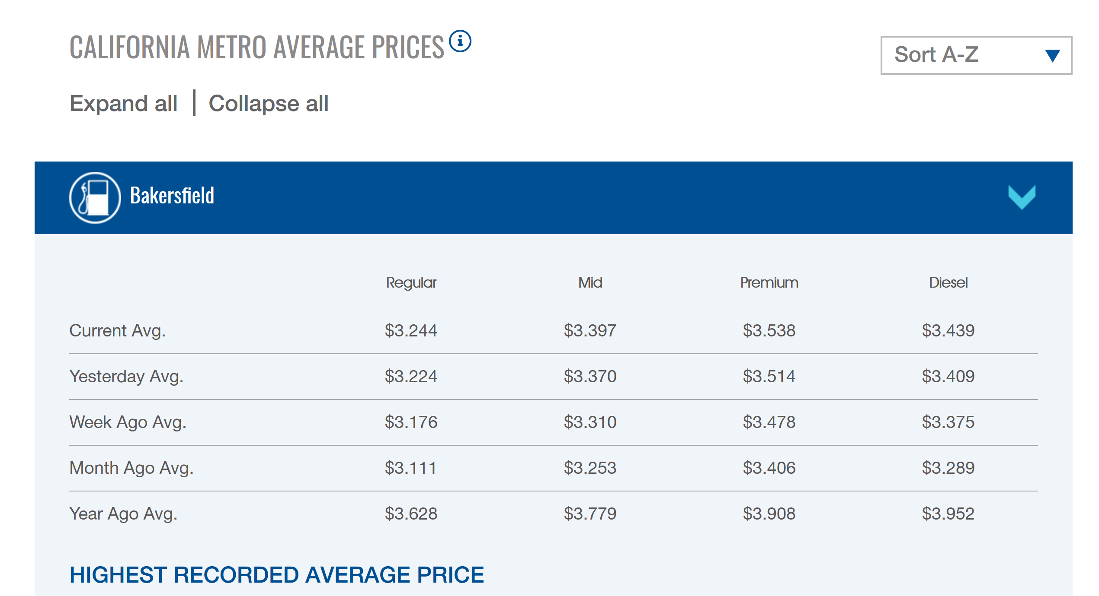
Q.4.2 – CA Gas Prices (cleaning)
Copy/pasted data directly off website onto Excel spreadsheet

Slide 26
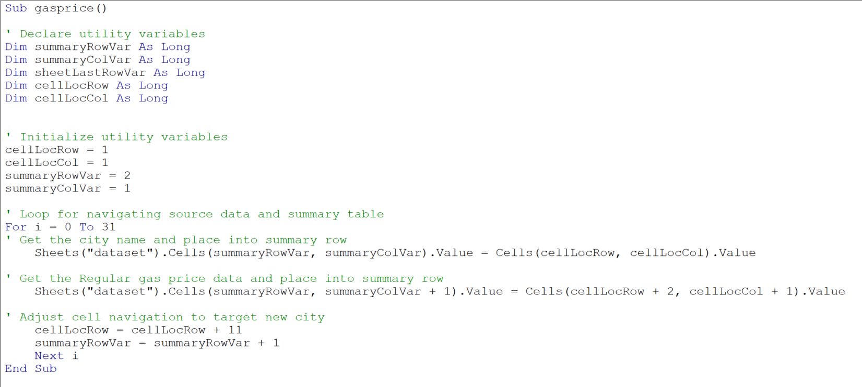
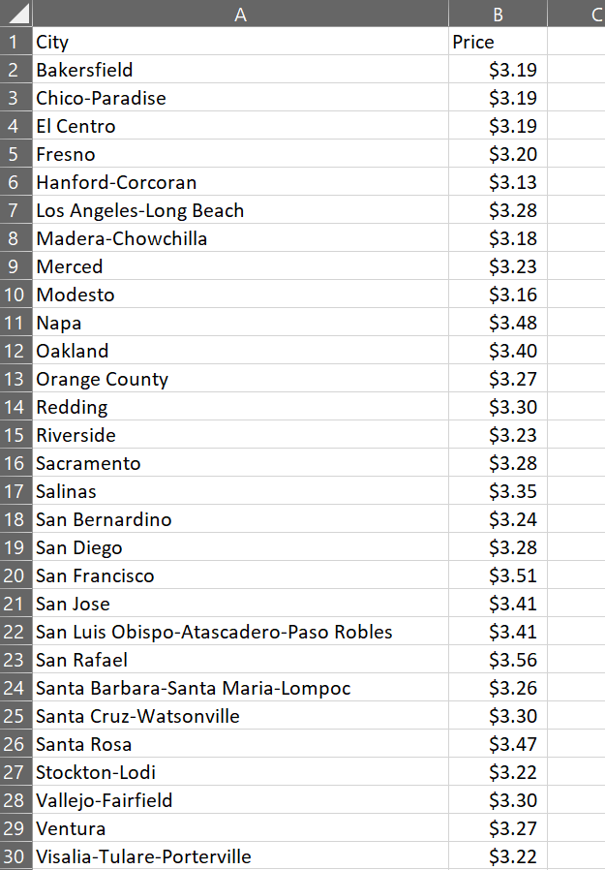
Q.4.2 – CA Gas Prices (cleaning)
Created crawler to pick out necessary data and create a summary table

Slide 27
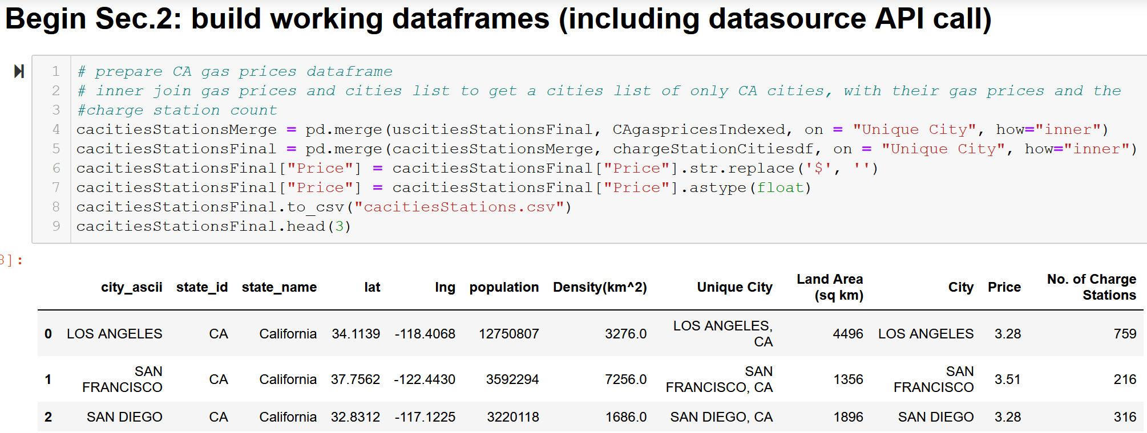
Q.4.2 – Cities data for Gas Prices (merging)
Creating CA-only list of cities and average gas prices (Regular octane gasoline) with number of EV charge stations for each city
Capitalize city name and add state abbreviation, and inner join on the unique cities

Slide 28
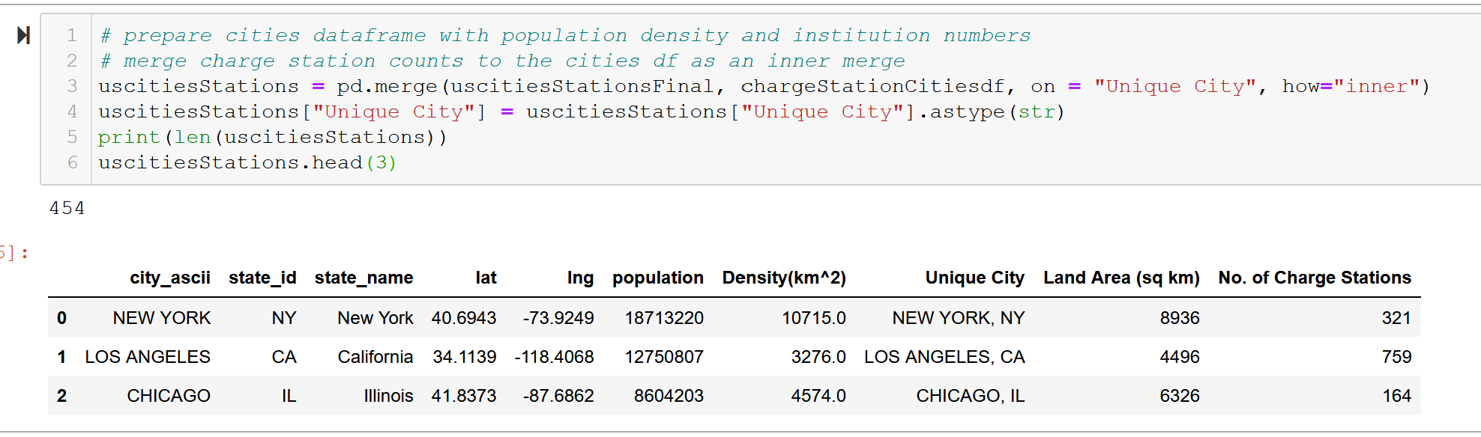
Q.4.1 – Cities Data for Population and “institutions” Studies
Inner join on state-unique cities
Change Price measures to floats

Slide 29
Q.4.3/4
Data cleaning/merging is finished for the first two studies
But what happened to the other two studies on the “institutions”???
(We’ll get back to these)

Slide 30
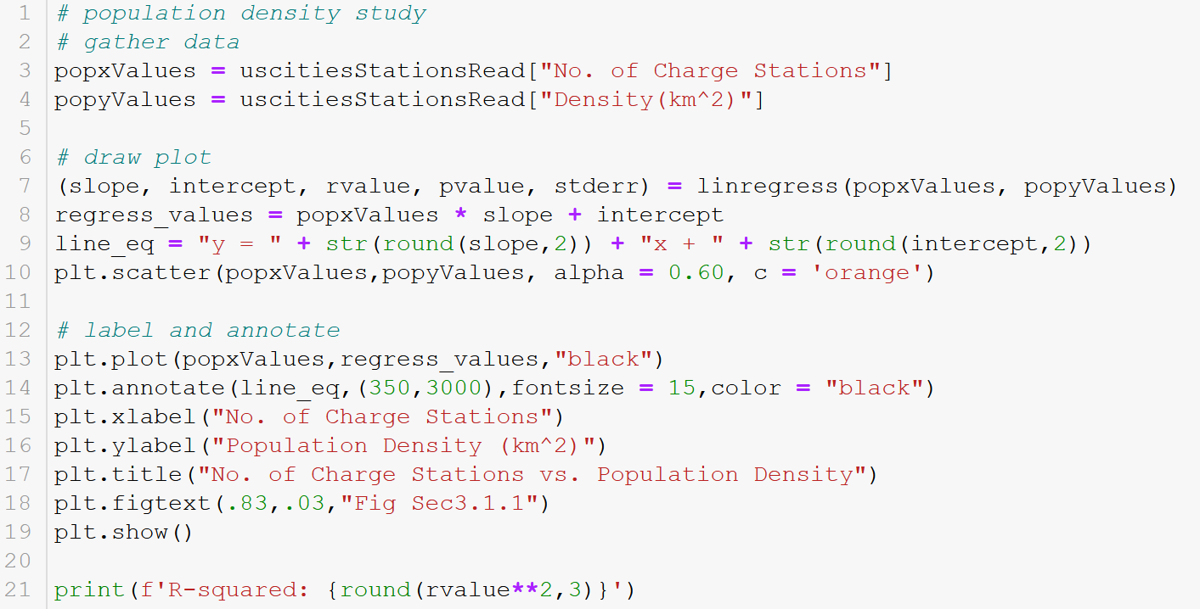
Q.4.1 – Creating scatterplot with R^2

Slide 31
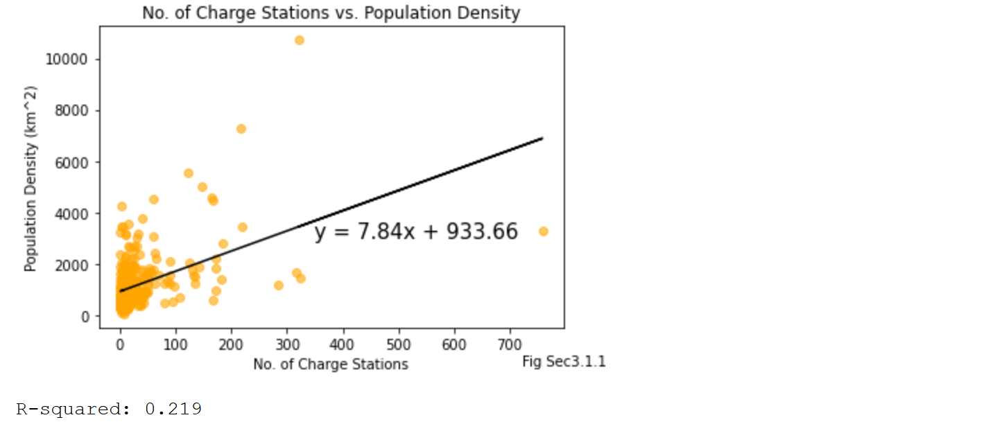
Q.4.1 – Scatterplot for Q.1

Slide 32
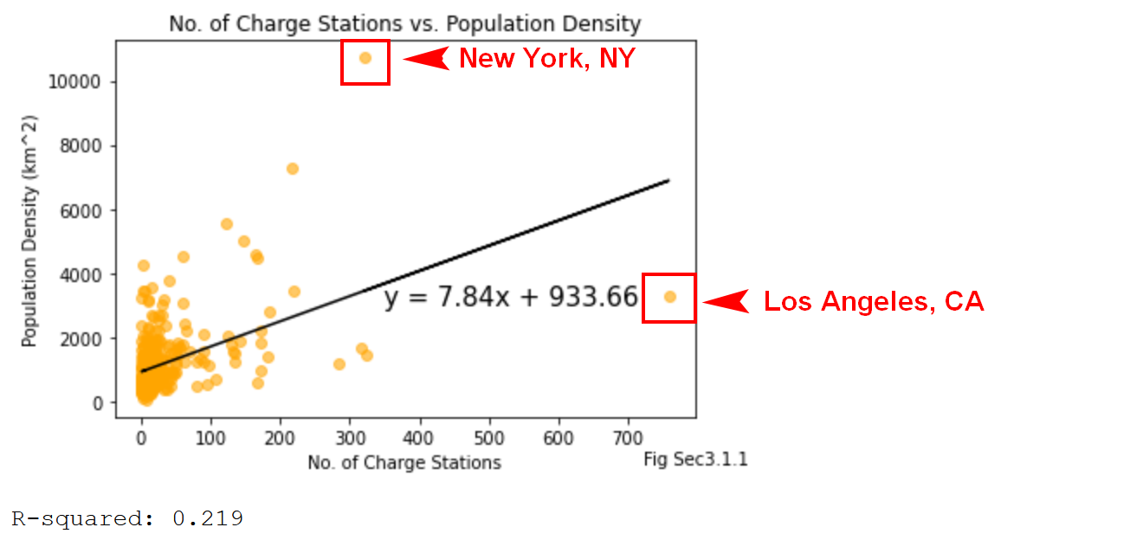
Q.4.1 – CA Cities data for population and “institutions” studies
Weak R-squared – likely no correlation between no. of charge stations and population density

Slide 33
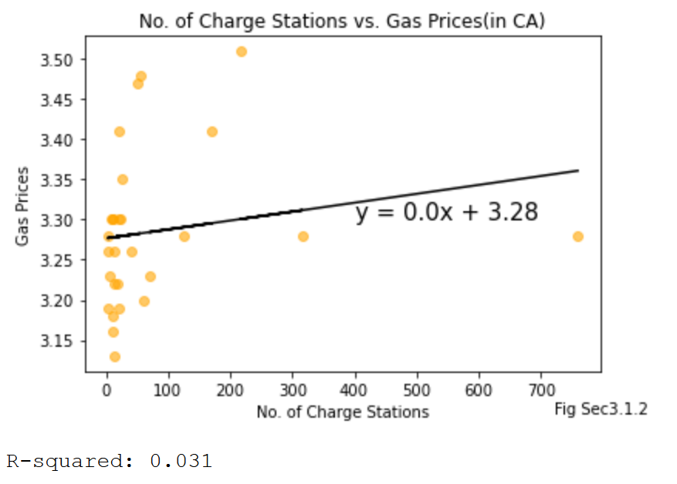
Q.4.1 – CA Cities data for population and “institutions” studies
Weak R-squared – likely no correlation between no. of charge stations and gas station prices
Higher R-squared than population density

Slide 34
Q.4.3/4 What else is there? (institution type 1)
Cities with a “techie” vibe
Representative of modern, trendy, forward-thinking demographics

Slide 35

Q.4.3/4 What else is there?

Slide 36
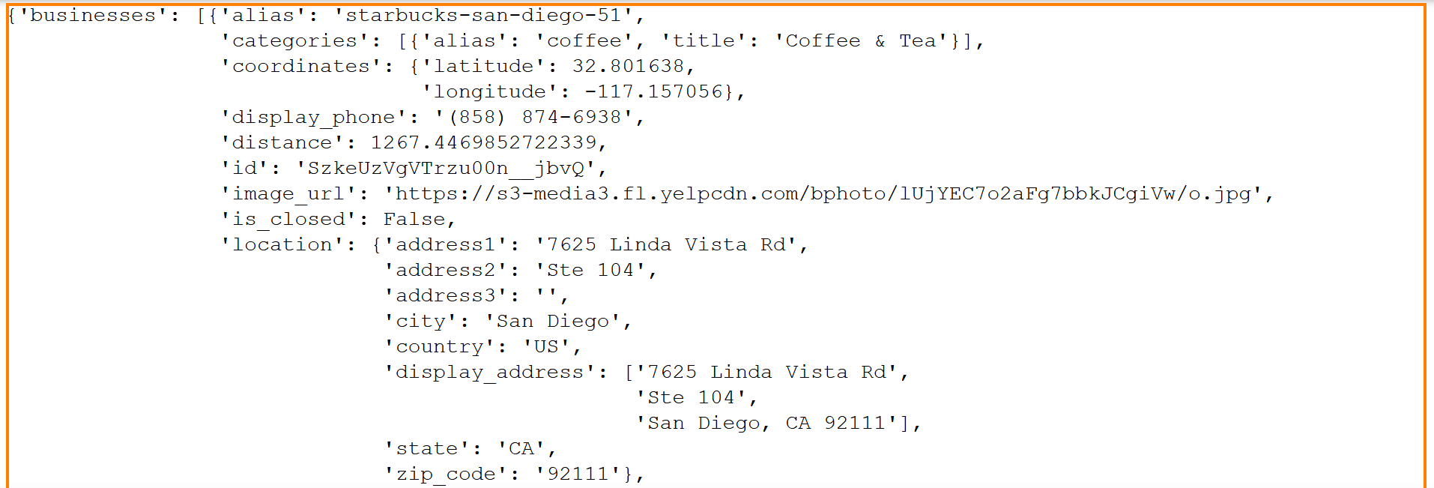
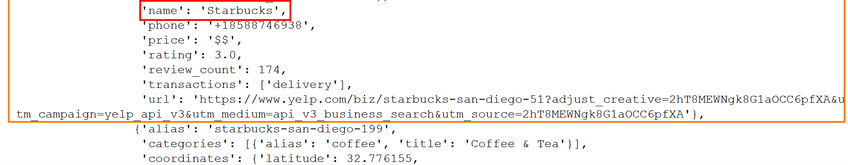
Q.4.3/4 – Yelp API
Use Yelp API to search for number of Starbucks in each city
Loop through the cities data frame and make calls to the API for each city
Read through the responses from one page to the next counting the number of times the search term is found
Stop the city’s query when a response that isn’t the search term is found

Slide 37
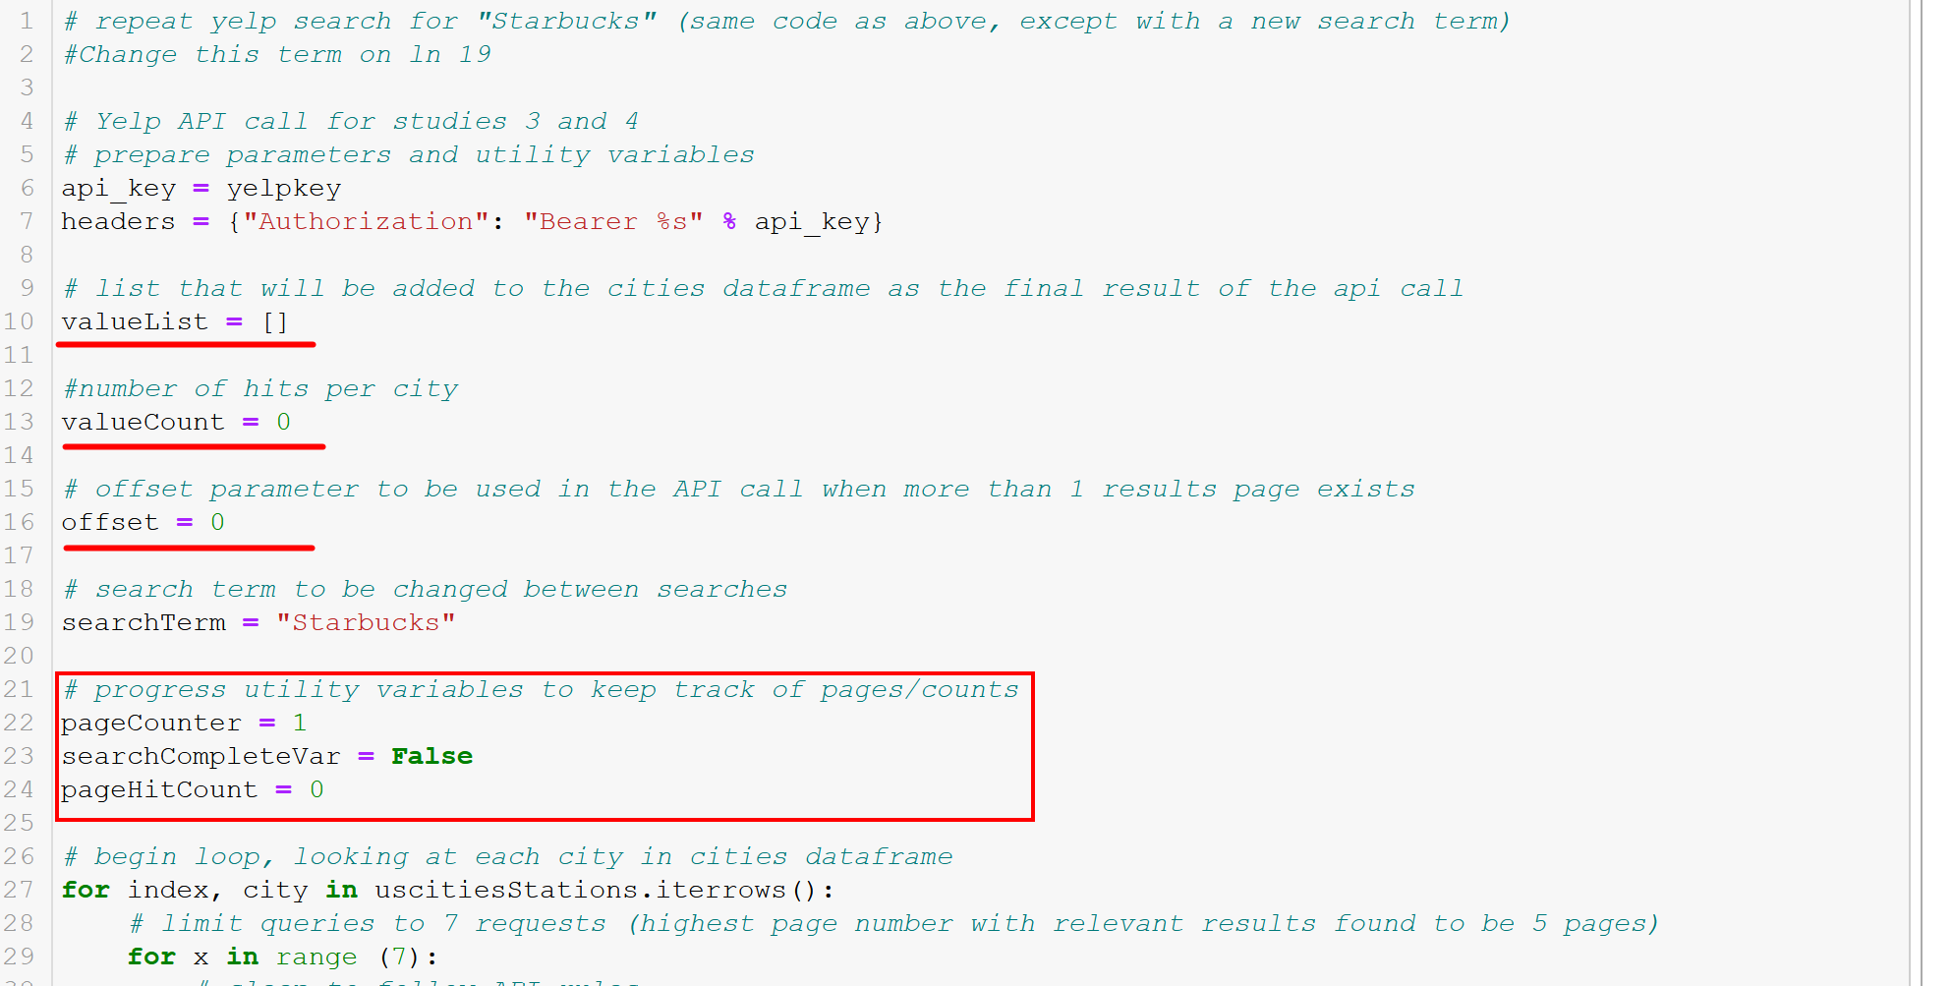
Q.4.3/4 – Yelp API

Slide 38
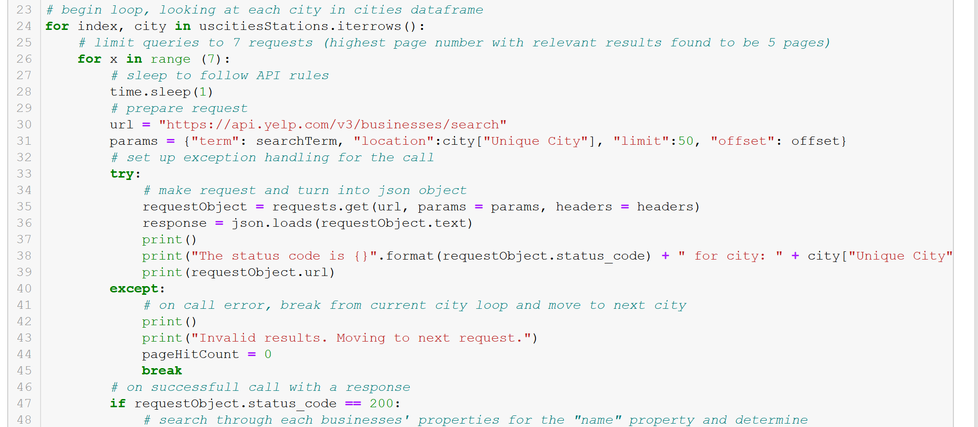
Q.4.3/4 – Yelp API

Slide 39
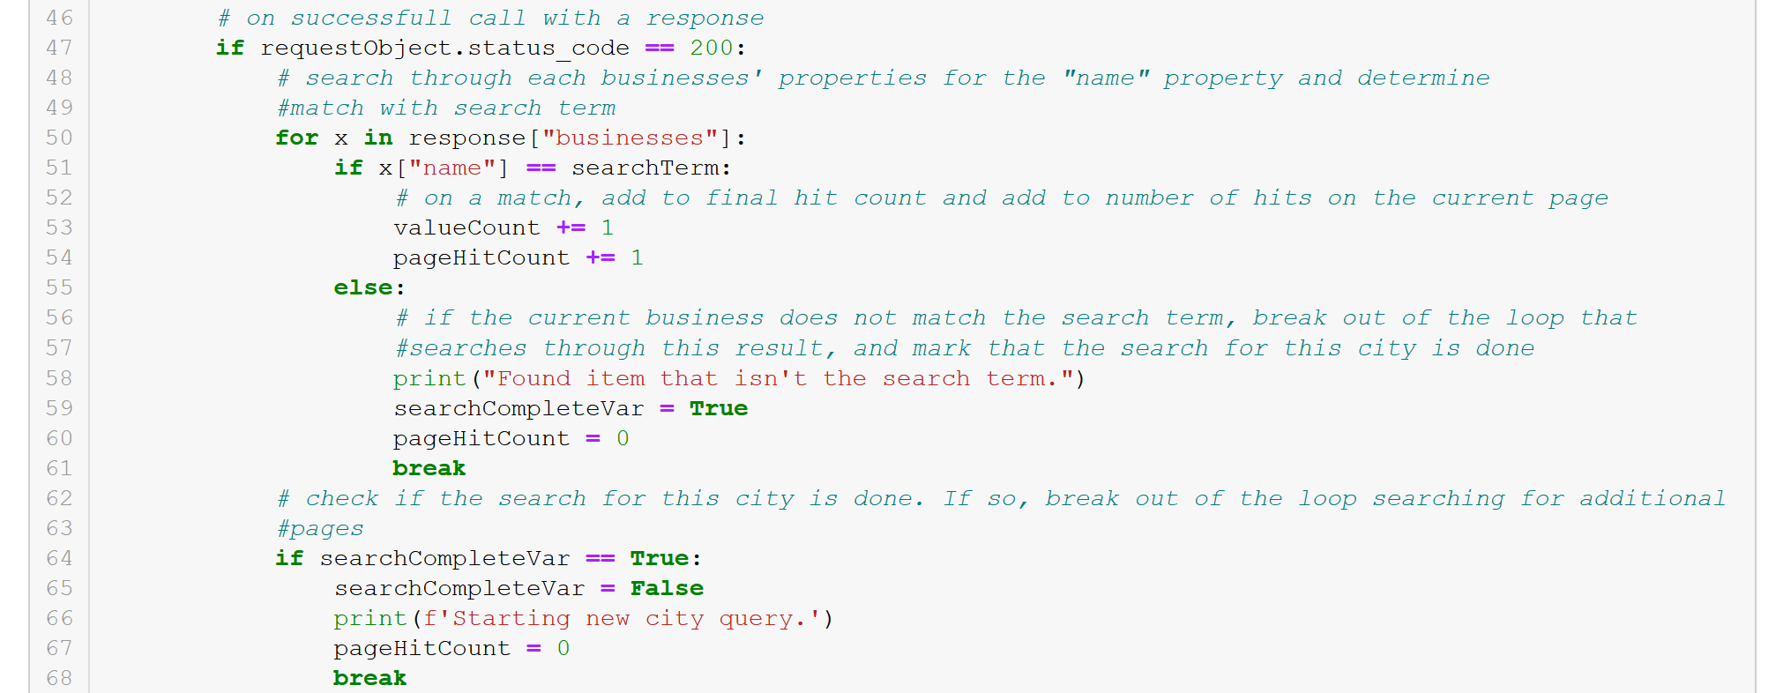
Q.4.3/4 – Yelp API
Add each search term hit to valueCount
Add each search term hit on current page response to pageHitCount (to check if the a new page will need to be searched for)
On the first “name” key where the value is not the search term, add the count value to the list for this city, indicate that the query for this city has ended (searchCompleteVar)

Slide 40
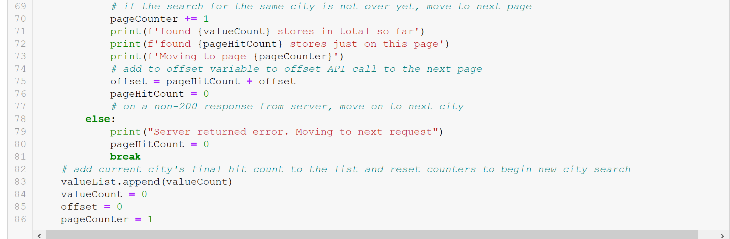
Q.4.3/4 – Yelp API
API allows a limit of 50 results per response
Check to see if the city’s query is not. If not, move to next page by adding the page’s hits to the result offset parameter for the API, and loop back to making a new query (same city, different page)
When this city’s query is complete (including additional pages) add search term hit count to the valueList and move to next city in cities data frame

Slide 41
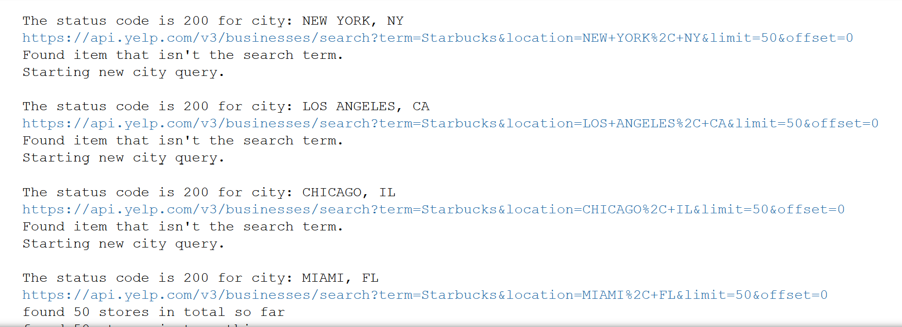
Q.4.3/4 – API Query Progress Tracking

Slide 42
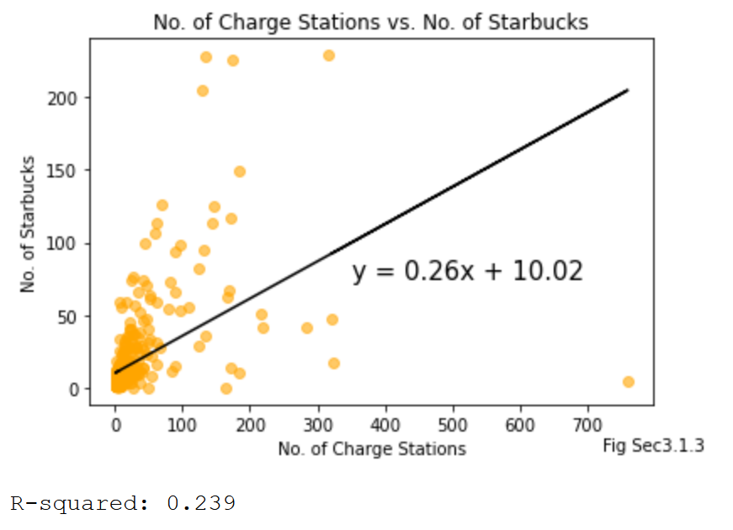
Q.4.3 – No. of Starbucks Study
Weak R-squared – likely no correlation between no. of charge stations and Starbucks
About as reliable as population density

Slide 43
Q.4.4 What else is there? (institution type 2)
Reflection of established infrastructure
Symbol of a “developed” society

Slide 44

Q.4.4 What else is there?

Slide 45
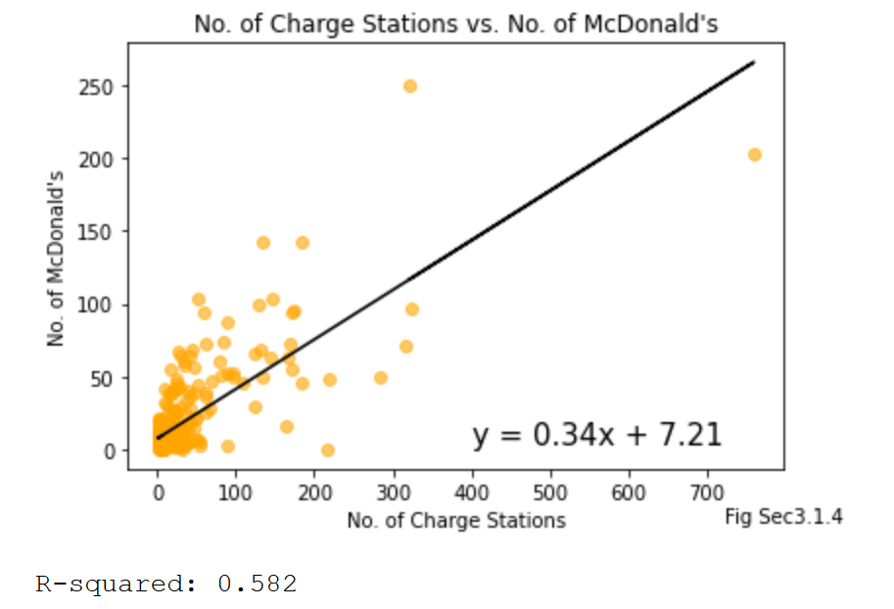
Q.4.4 – No. of McDonald’s
Moderate R-squared – possible correlation between no. of charge stations and McDonald’s (though not likely)

Slide 46


Q.4.4 A Thought
“Are McDonald’s and Tesla conspiring together on a secret partnership?!?!”
*Todd did not understand the concept of “correlation does not equal causation”

Slide 47
Q.4 Summary
Few properties of a city reflect charge station availability
Los Angeles, CA potentially skews the study with a large amount of charge stations (reflect on what constitutes as an “outlier” for correlational studies)

Slide 48


The “Electric” Craving

Slide 49


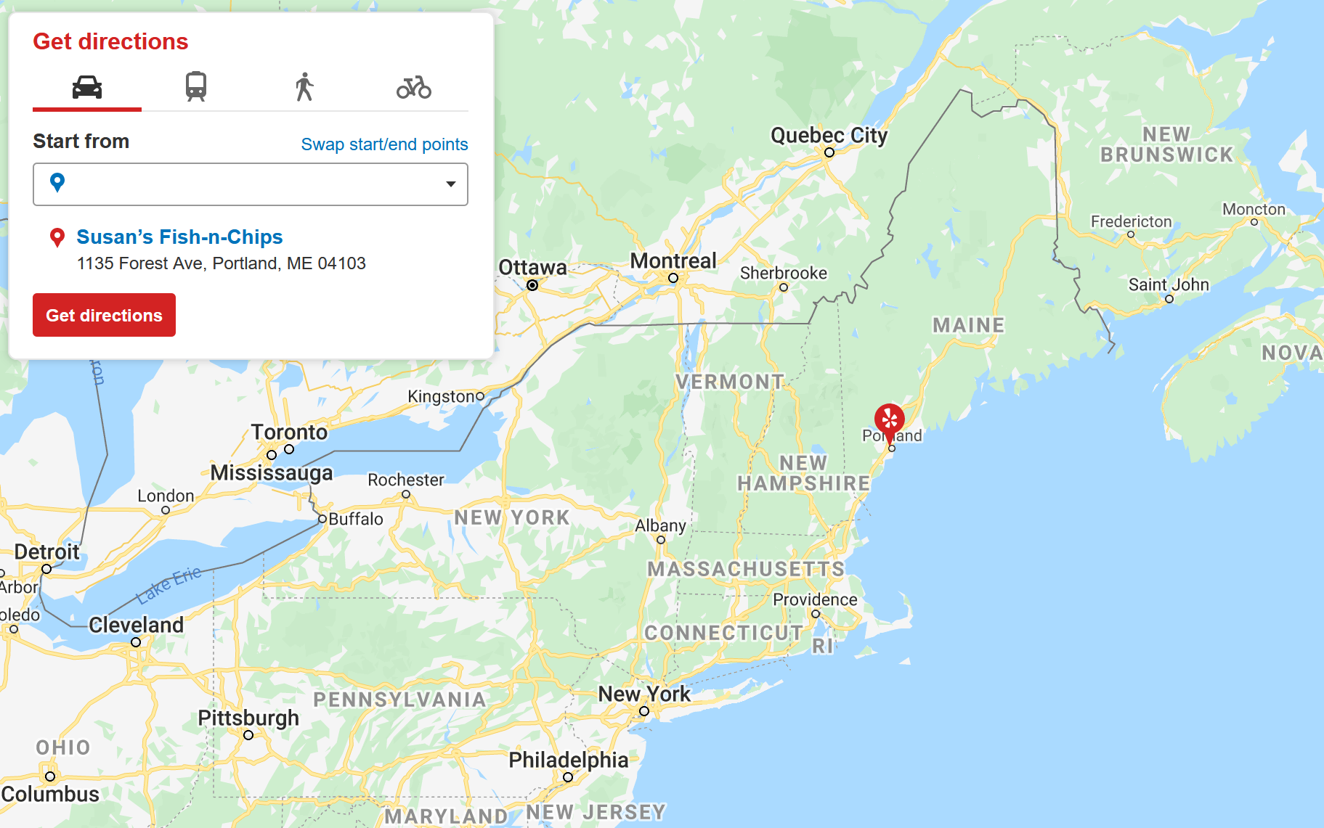
The “Electric” Craving
Todd needs a genuine northeastern lobster roll RIGHT NOW
Great place on Yelp in Portland, Maine!

Slide 50
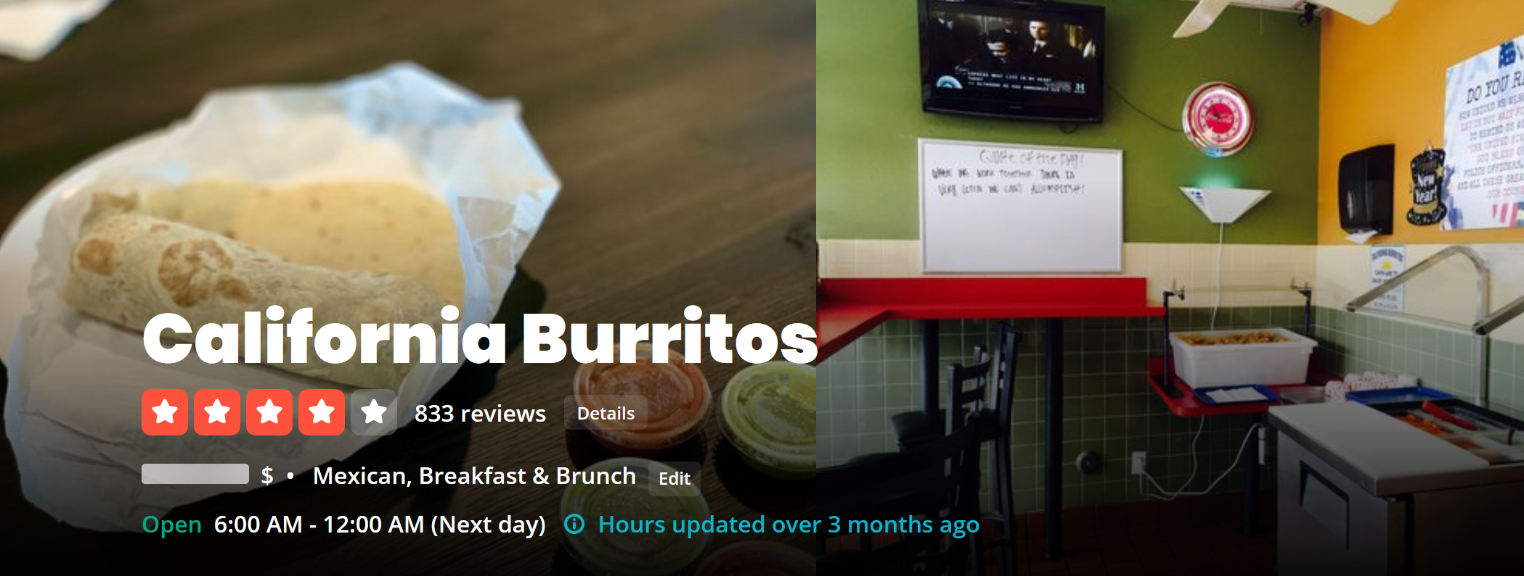
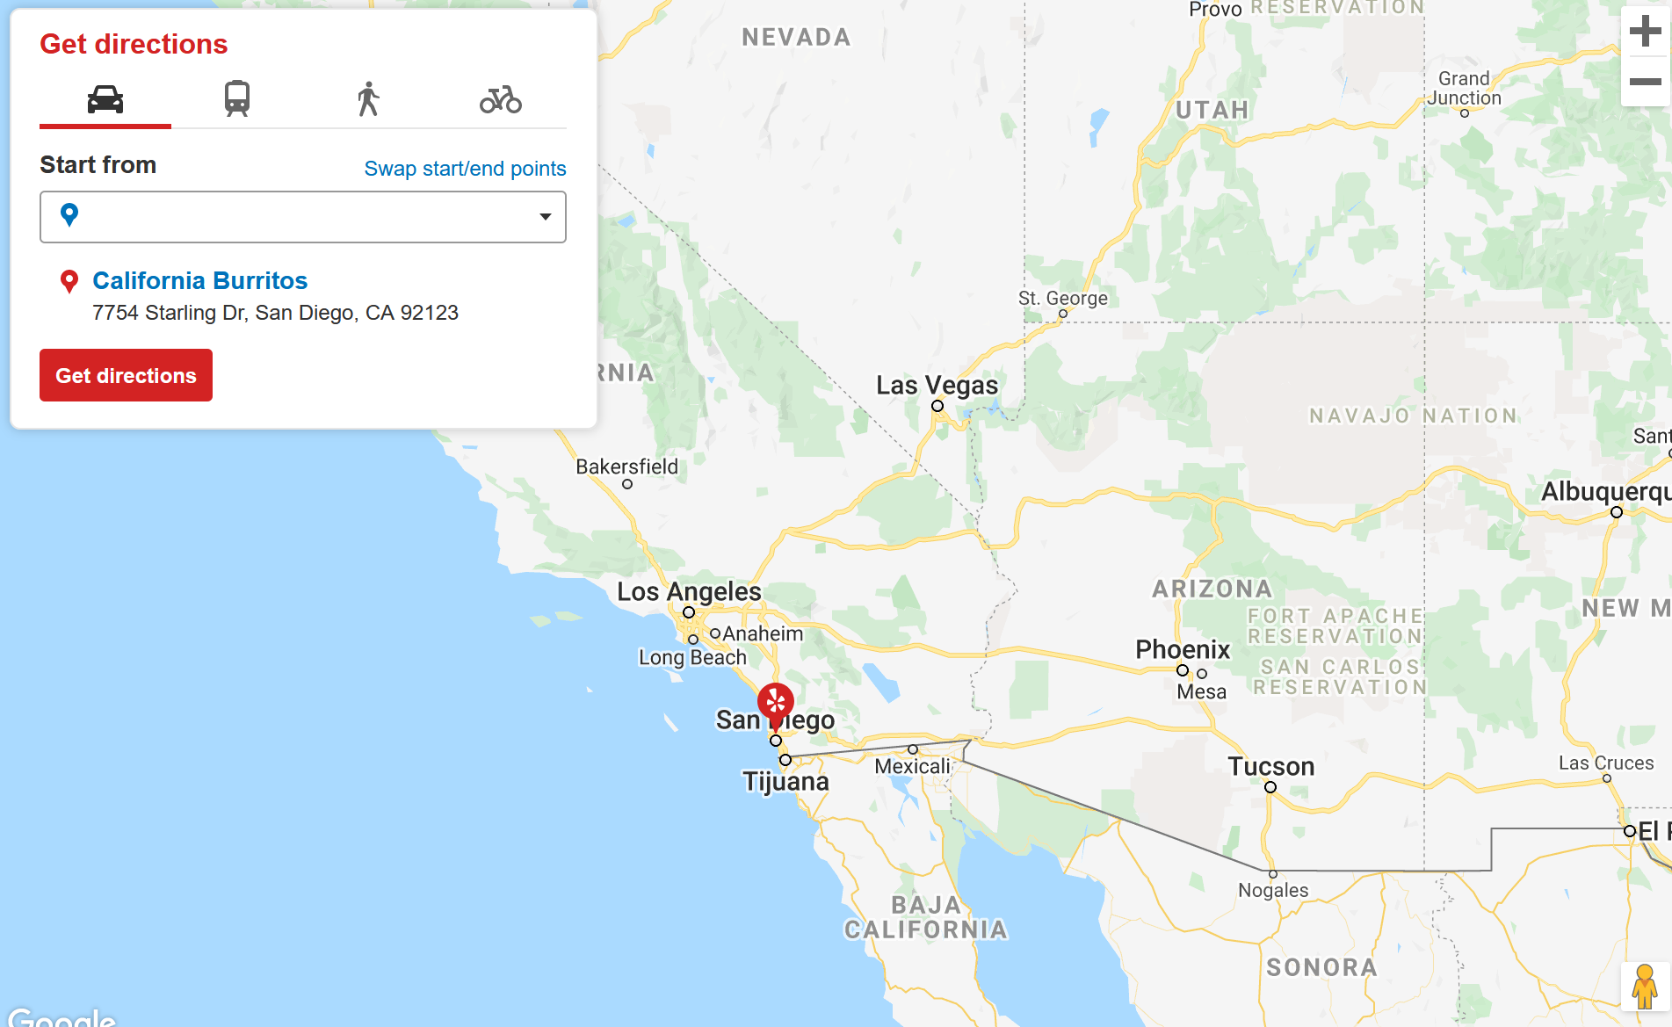
The “Electric” Craving
Just finished eating a California burrito in in San Diego, California

Slide 51
The “Electric” Craving
How many cross-country trips would it take to pay off the purchase price difference between the Tesla and the XXXXX?

Slide 52
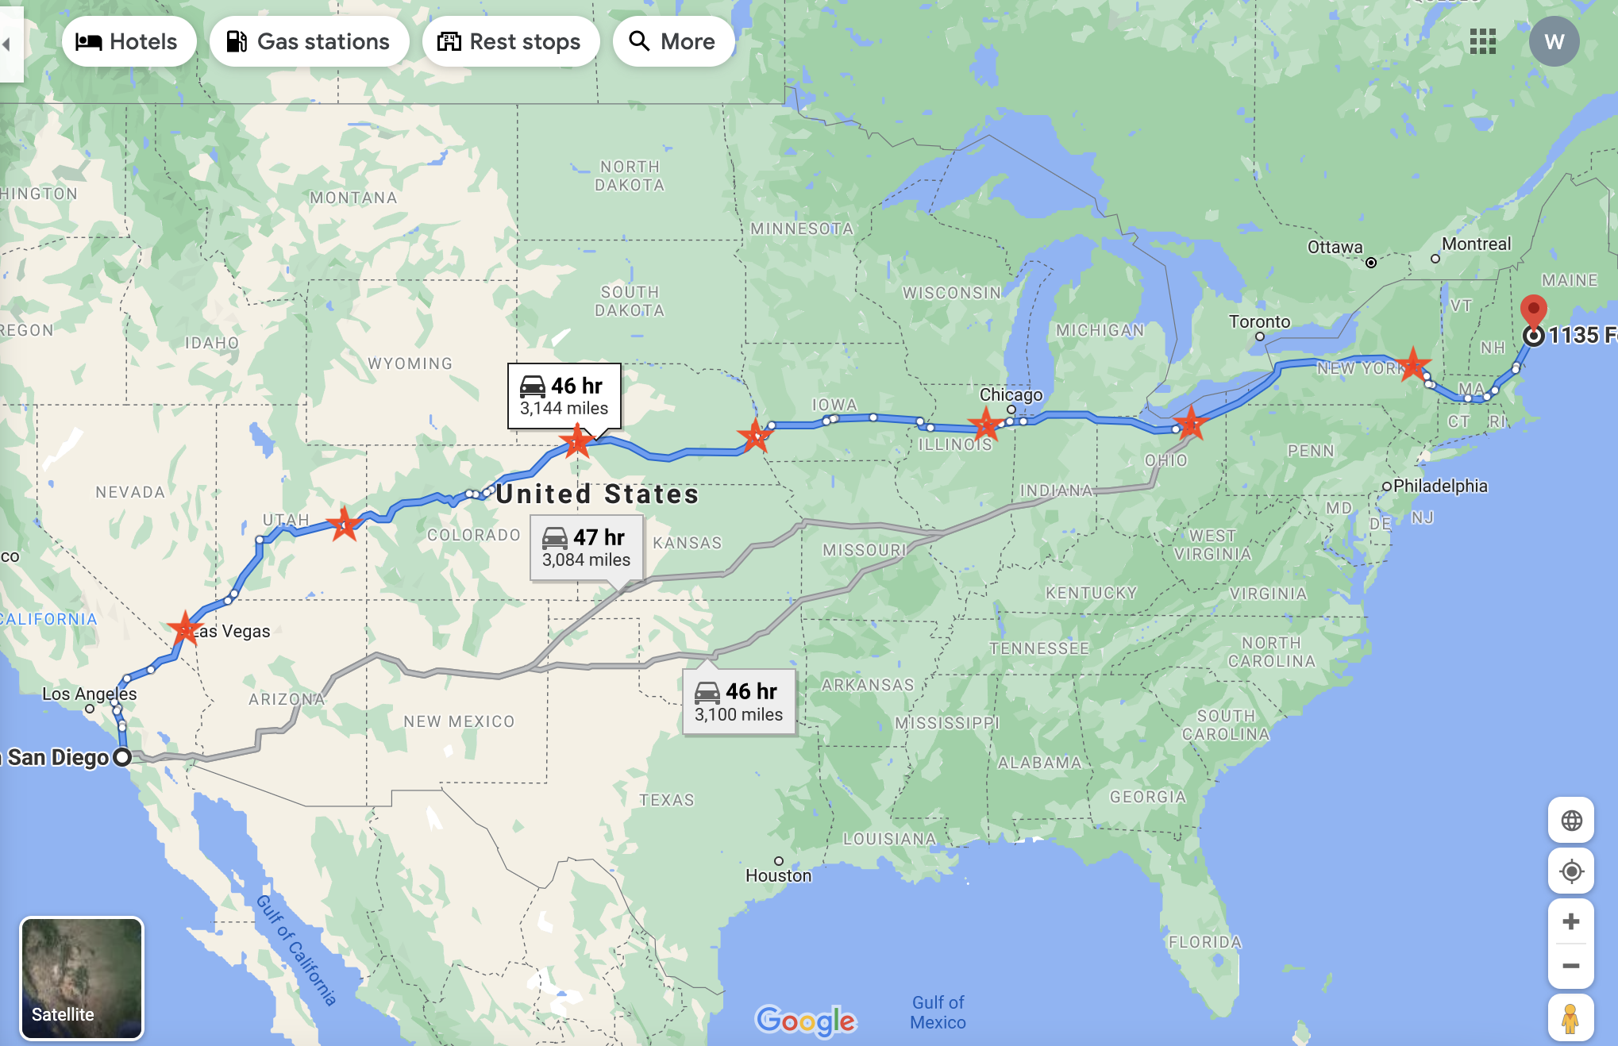
Trip Stops for Fuel

Slide 53
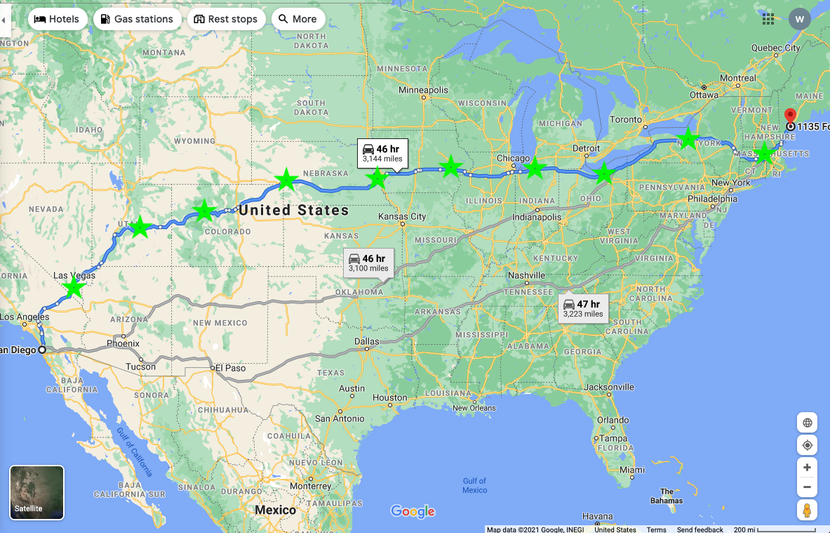
Trip Stops for Charge

Slide 54
The “Electric” Craving
Electric Vehicle
Stop Location | Cost to Refuel
Pahrump, Vegas | $10.00
Price, Utah | *$0.00
Glenwood-Springs, Colorado | $32.25
Scottsbluff, Nebraska | **$0.50
Lincoln, Nebraska | **$0.25
Iowa City, Iowa | **$0.70
Elkhart-Goshen, Indiana | $5.00
Cleveland-Elyvia, Ohio | **$1.00
Binghamton, New York | $9.00
Worcester, Massachusetts | $11.25
Total | $69.95
Gas-powered Vehicle
DISCUSS WITH TEAM FOR CHANGES
7-stops version
Which car? F150 or Camry
Gas Route Map
Stop Location | Cost to Refuel
Central Valley, Utah | $44.40
Big Spring, Nebraska | $44.80
Grinnell, Iowa | $44.60
Cleveland, Ohio | $45.20
Worcester, Massachusetts | $45.20
Total | $224.20
Electric Route Map

Slide 55
The “Electric” Craving
Car Model | Gas/ Battery Capacity | Miles / Filling | Stops / Trip | Fuel/ Charge fees per Trip | Ave. Car Price
Ford F Series | 23 gal | 690 | 5 / 7 | $224.20 | $51,585.00
Tesla 3 | 75 kWh | 348 | 10 | $69.95 | $48,190.00
How much more expensive the Tesla M3 price is: | $3,395.00
How much cheaper the EV charge costs are for entire trip: | $154.25
How much of the difference in MSRP is paid for by the savings in fuel: | 4.54%
How many one-way trips need to be made for the Tesla M 3 to pay itself off in fuel savings: | 22

Slide 56


The “Electric” Craving
Which means: how many more San Diego California burritos and Portland, Maine lobster rolls does Todd need to eat in order for the Tesla Model 3 to pay itself off in fuel costs?
CA Burrito | Lobster Rolls
11 | 10
Todd senses a sudden craving for another California burrito…

Slide 57
Sources
(2021). Geeme. https://geeme.now.sh/
(2021). vecteezy. https://www.vecteezy.com/free-vector/sandwich

Slide 58
An Electric Craving
UCSD Data Science and Programming Bootcamp
Project One
Jacob Zacarias
Sanabu Washizuka
Tanlin Hung
Walaa Alani

Slide 59
Topic Slide
CONTENT HERE

Slide 60
Subtitle
CONTENT HERE

